Slide 1

Creating Great Looking Android Applications Using Material Design
Kevin Ford
Mobile Practice Lead
Magenic
Level: Intermediate

Slide 2
Why is Design Important

Slide 3
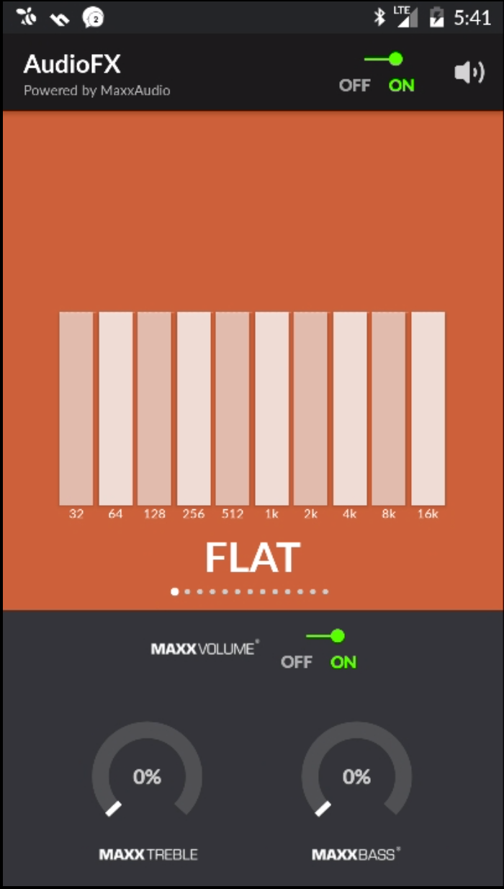
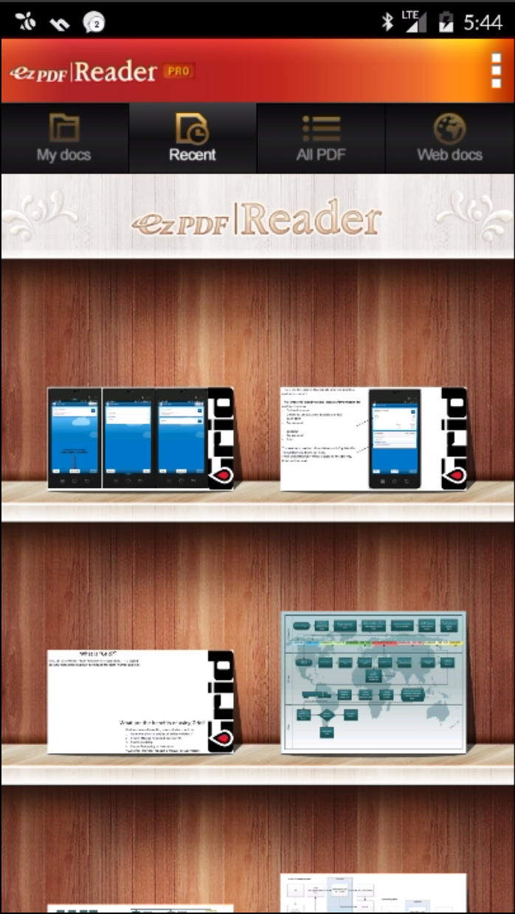
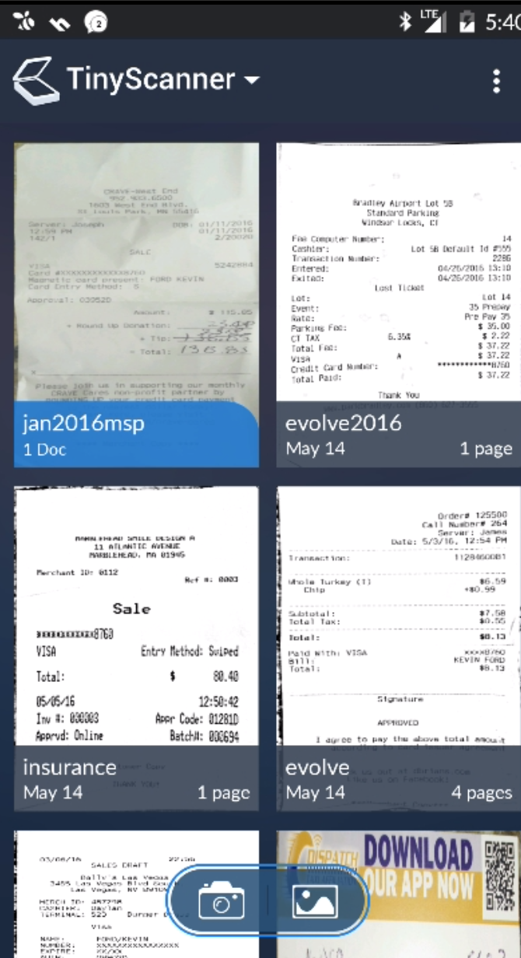
Notes:
Is this even the same platform?

Slide 4
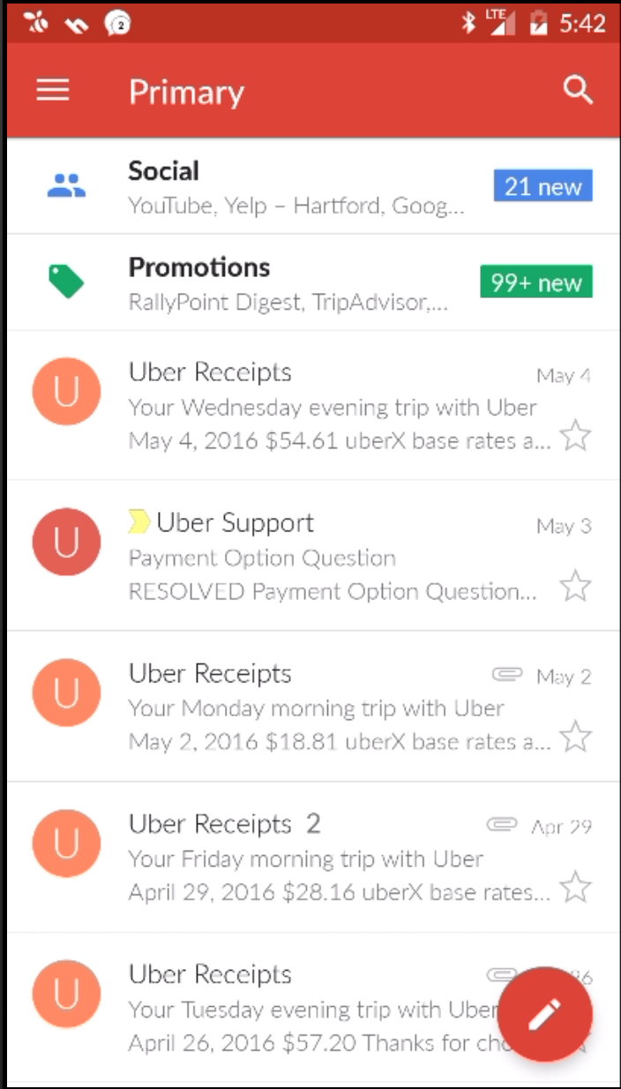
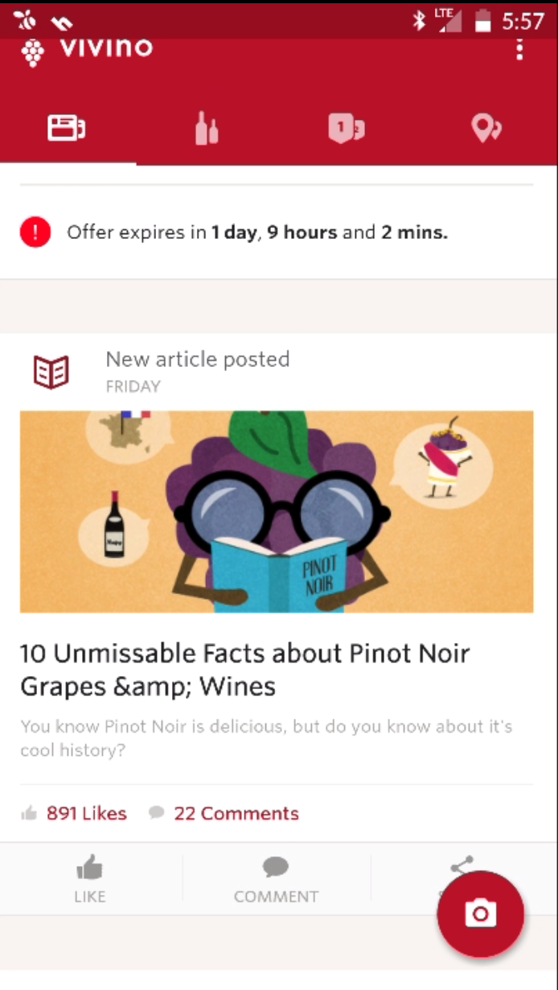
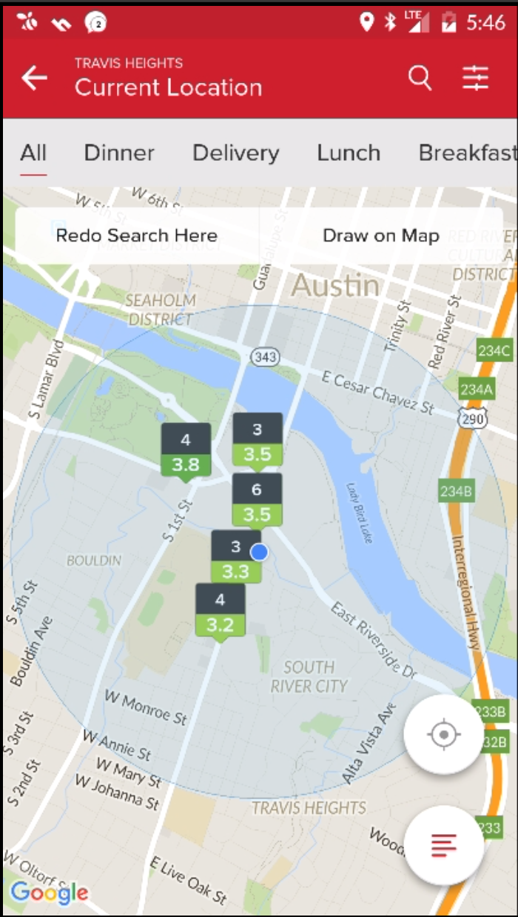

Slide 5
What Is Material Design?
First Unified Design for Android
Introduced with Android L
Guidelines Quite Specific
Special Tooling Libraries
Libraries Backward Compatible (v7)

Slide 6
Material Design Concepts
“… guided by print-based design elements – such as typography, grids, space, scale, color, and imagery”
Material Metaphor
Bold, Graphic, Intentional
Motion Provides Meaning

Slide 7
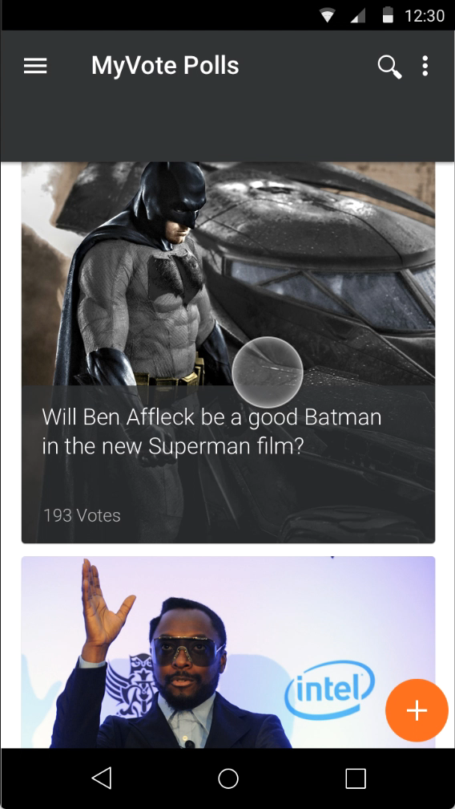
Getting a Design

Slide 8
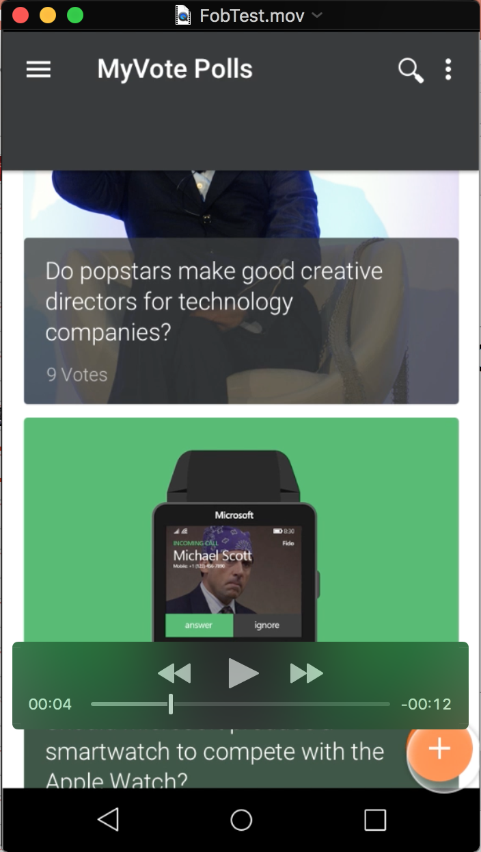
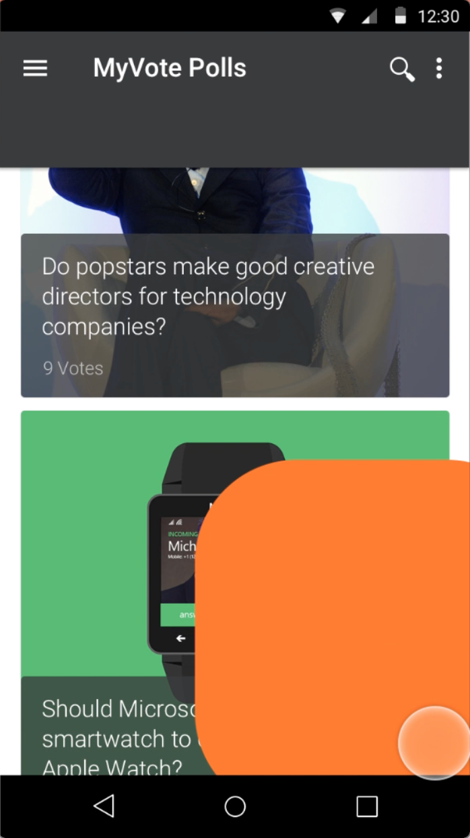
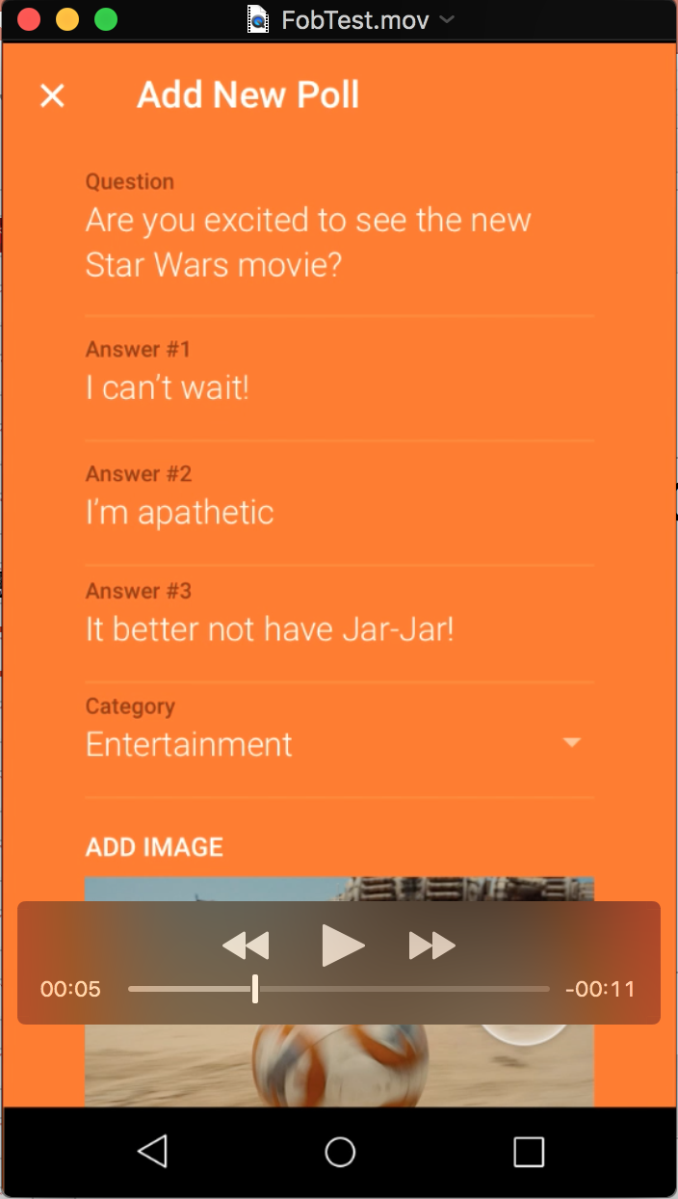
Parsing the Design
Styles and Themes
Elevation and Shadows
Floating Action Button
Recycler View
Card View
Animations
Icons
Action Bar

Slide 9
Styles and Color Schemes
Handled through Themes
Pallets are Complimentary
Colors to consider
Primary
Secondary
Accent
Notes:
Primary - color should be the most widely used across all screens and components.
Secondary - to indicate a related action or information. The secondary color may be a darker or lighter variation of the primary color.
Accent - used for the floating action button and interactive elements,

Slide 10
Material Design Themes
Require Android L for Material themes (values-v21)
Example: @android:style/Theme.Material.Light
Use AppCompat themes for Older API Support (v7)
Example: Theme.AppCompat.Light
Activities my inherit from AppCompatActivity
Themes control appearance of default action bar

Slide 11
Sample Style
<style name="Theme.MyTheme" parent="@style/Theme.AppCompat.Light.NoActionBar">
<item name="colorPrimary">@color/custom_primary</item>
<item name="colorPrimaryDark">@color/custom_secondary</item>
<item name="colorAccent">@color/custom_accent</item>
</style>

Slide 12
Day / Night Theme
Introduced in AppCompat 23.2.0
Switches between Dark and Light mode
Theme.AppCompat.DayNight
Several Settings
Light
Dark
Auto

Slide 13
Elevation and Shadows
All material objects have default elevation
Some objects change elevation based on input
Material cannot pass through material
Shadows are visual cue of elevation
Set elevation: setCompatElevation or elevation XML attribute
Override shadow: setOutlineProvider(ViewOutlineProvider)

Slide 14

Elevation Limitations
All elements are 1dp thick (think paper)
Multiple objects cannot share the same space
Objects cannot pass through each other
10 dp
9 dp
8 dp
7 dp
4 dp
3 dp

Slide 15
Responsive Elevation
Sometimes Elevation changes as state changes
Resting elevation vs goal elevation
Changes handled using Dynamic Elevation Offsets
Provide consistency in changes
Objects return to resting elevation when done
TranslationZ
Goal
Elevation
Resting

Slide 16
Floating Action Button
Purpose to show form’s primary action
android.support.design.widget.FloatingActionButton
Theme accent color is default background
Default and ‘mini’ size - fabSize
Android:src or setImageDrawable to change icon
Normally, leave elevation/shadow to defaults

Slide 17
Floating Action Button XML
<android.support.design.widget.FloatingActionButton
android:id="@+id/fab_add"
android:layout_width="wrap_content"
android:layout_height="wrap_content"
android:layout_gravity="bottom|right"
android:layout_marginBottom="16dp"
android:layout_marginRight="16dp"
android:enabled="true"
android:src="@drawable/ic_add_white_24dp" />

Slide 18
Wiring Up the FAB Click Event
In OnCreate:
var fab = FindViewById<FloatingActionButton>(Resource.Id.fab_add);
fab.Click += fab_click;
Event:
private void fab_click(object sender, EventArgs e)
{
var intent = new Intent(this, typeof(NewPollActivity));
ActivityCompat.StartActivity(this, intent, null);
}

Slide 19
Recycler View
Can use instead of ListView
Handles vertical and horizontal scrolling
Follows View Holder Pattern
android.support.v7.widget.RecyclerView
Need: LayoutManager, ViewHolder, adapter

Slide 20
RecyclerView XML
<android.support.v7.widget.RecyclerView
android:layout_width="match_parent"
android:layout_height="match_parent"
android:id="@+id/poll_list" />

Slide 21
Creating a View Holder
public class PollItemViewHolder : RecyclerView.ViewHolder
{
public ImageView PollImage { get; private set; }
public TextView PollDescription { get; private set; }
public TextView PollVoteCount { get; private set; }
public PollItemViewHolder(View itemView) : base(itemView)
{
// Locate and cache view references:
PollImage = itemView.FindViewById<ImageView>(Resource.Id.poll_image);
PollDescription = itemView.FindViewById<TextView>(Resource.Id.poll_description);
PollVoteCount = itemView.FindViewById<TextView>(Resource.Id.poll_votes);
}
}

Slide 22
Creating a Layout Manger
LinearLayoutManager
StaggeredGridLayoutManager
GridLayoutManager
Custom: extend RecyclerView.LayoutManager
var recyclerView = FindViewById<RecyclerView>(Resource.Id.poll_list);
var layoutManager = new LinearLayoutManager(this);
layoutManager.Orientation = LinearLayoutManager.Vertical;
recyclerView.SetLayoutManager(layoutManager);

Slide 23
Creating an Adapter - Partial
public class PollAdapter : RecyclerView.Adapter
{
public override RecyclerView.ViewHolder OnCreateViewHolder(ViewGroup parent, int viewType)
{
// Inflate the CardView for the photo:
View itemView = LayoutInflater.From(parent.Context).Inflate(Resource.Layout.MainRow, parent, false);
// Create a ViewHolder to hold view references inside the CardView:
var vh = new PollItemViewHolder(itemView);
return vh;
}
}

Slide 24
Putting it all Together
var recyclerView = FindViewById<RecyclerView>(Resource.Id.poll_list);
var layoutManager = new LinearLayoutManager(this);
layoutManager.Orientation = LinearLayoutManager.Vertical;
recyclerView.SetLayoutManager(layoutManager);
var pollService = new PollService();
var pollItems = pollService.GetPolls();
var adapter = new PollAdapter(pollItems);
recyclerView.SetAdapter(adapter);

Slide 25
ListView or RecyclerView?
ListView Advantages
RecyclerView Advantages
Easy to handle taps at the row level
Easy to handle taps at the view level
Dividers
Formal layouts like horizontal scrolling
Canned simple adapters
Forces view holder pattern
Decorators and animations

Slide 26
Card View
Present related information
android.support.v7.widget.CardView
Requries API 21 and JDK 1.7
Differences prior to API 21 (App Compat)
Calculated shadow adds padding -cardUseCompatPadding
Intersecting child views not clipped in corners - cardPreventCornerOverlap

Slide 27
CardView XML
<android.support.v7.widget.CardView
android:layout_height="0dp"
android:layout_width="0dp"
app:layout_aspectRatio="100%"
app:layout_widthPercent="100%”
app:cardElevation="2sp"
app:cardUseCompatPadding="true" >
<ImageView
android:layout_height="match_parent"
android:layout_width="match_parent"
android:id="@+id/poll_image"
android:scaleType="centerCrop" />
</android.support.v7.widget.CardView>

Slide 28
Animations - Transitions Framework
Animates Change between one view hierarchy and another
Key Concepts
Scenes
Transitions
Not compatible with classes that extend adaper view
Problems animating views that contain text

Slide 29
Tying Source and Target Controls
Source:
<android.support.design.widget.FloatingActionButton
android:id="@+id/fab_add"
android:layout_width="wrap_content"
android:layout_height="wrap_content"
android:transitionName="@string/Transition_Popup"
android:src="@drawable/ic_add_white_24dp" />
Target:
<android.support.design.widget.CoordinatorLayout
android:layout_width="match_parent"
android:layout_height="match_parent"
android:transitionName="@string/Transition_Popup"
android:background="@color/custom_accent">

Slide 30
Making the Transition
private void fab_click(object sender, EventArgs e)
{
var intent = new Intent(this, typeof(NewPollActivity));
var transitionName = GetString(Resource.String.Transition_Popup);
var fab = FindViewById<FloatingActionButton>(Resource.Id.fab_add);
var options = ActivityOptionsCompat.MakeSceneTransitionAnimation(this, fab, transitionName);
var bundle = options.ToBundle();
ActivityCompat.StartActivity(this, intent, bundle);
}

Slide 31
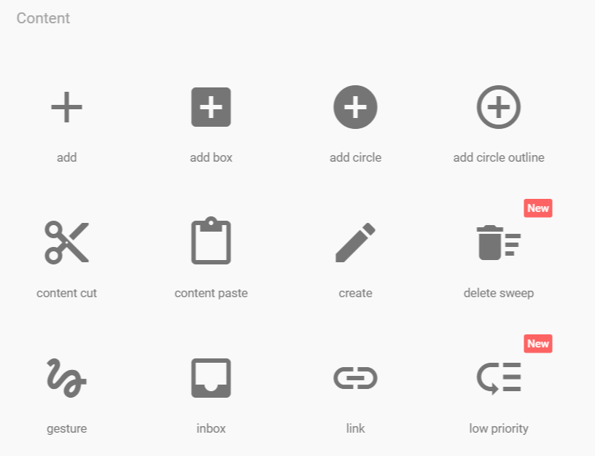
Icons
Available from Google
https://design.google.com/icons/
Android, iOS and web sizes
Black and white colors (light and dark)

Slide 32
Action Bar Style
<style name="ToolbarTheme" parent="Theme.AppCompat.NoActionBar">
<item name="android:textColorPrimary">@android:color/white</item>
<item name="actionMenuTextColor">@android:color/white</item>
<item name="android:textColorSecondary">@android:color/white</item>
</style>

Slide 33
Action Bar XML
<android.support.v7.widget.Toolbar
android:id="@+id/toolbar"
android:layout_width="match_parent"
android:layout_height="wrap_content"
android:background="@color/custom_primary"
app:navigationIcon="@drawable/ic_menu_white_24dp"
android:theme="@style/ToolbarTheme" />

Slide 34
Action Bar Extra Menu Items
<menu xmlns:android="http://schemas.android.com/apk/res/android"
xmlns:app="http://schemas.android.com/apk/res-auto">
<item
android:id="@+id/action_search"
android:title="Search"
android:icon="@drawable/ic_search_white_24dp"
android:orderInCategory="100"
app:showAsAction="ifRoom" />
<item
android:id="@+id/action_settings"
android:title="Some Menu Item"
android:orderInCategory="300"
app:showAsAction="never" />
</menu>

Slide 35
Action Bar In Code
In OnCreate Method
var appBar = FindViewById<Toolbar>(Resource.Id.toolbar);
appBar.InflateMenu(Resource.Menu.Main_Menu);
SetSupportActionBar(appBar);
appBar.NavigationClick += Navigation_Click;
Handle Inflating extra menu items
public override bool OnCreateOptionsMenu(IMenu menu)
{
var inflater = MenuInflater;
inflater.Inflate(Resource.Menu.Main_Menu, menu);
return base.OnCreateOptionsMenu(menu);
}

Slide 36

Bottom Navigation
Added to Material Design Guidelines
Control Added in version 25.0.0 of Compatibility Libraries
Should only have 3 - 5 items
Focus item should be primary color
Back button doesn’t navigate between bar views

Slide 37
Useful Links
Sample Code: https://github.com/Bowman74/VSLiveMaterialDesign
Material Design Standards: http://www.google.com/design/spec/material-design/introduction.html
Icons:
https://design.google.com/icons/
Developer Information: https://developer.android.com/design/material/index.html

Slide 38
Thanks!!!

